Slide 1
Panda Mall
Asjad Iftikhar 18L-0951
M. Zain Arshad 18L-1109
Tayyab Waseem 18L-1017

Slide 2
Problem statement
01
Goals and scope
02
Table of contents
Overview of System
03
Work Breakdown
04
Type of Project
Future Goals
Constraints and Limitations
Timelines

Slide 3
Panda Mall
A Website based on Machine Learning recommendation system for online shopping.
Hundreds of online shopping stores
Covid 19 pandemic restrictions
But why?

Slide 4
Problem Statement
The need
0.3%
3g/4g
39%
E-Commerce Boom
Connectivity
Apparels

Slide 5
Problem Statement (cont)
Choice Overload
Example
AI based development project
Solution

Slide 6
Problem Statement (cont)
During the Covid 19 Pandemic Hundreds of online shopping stores popped up leaving shoppers with an arduous task of browsing the web for best products. Panda Mall aims to take this task in its own hands and give shoppers a manageable list of products they are most likely to love. Moreover, it provides brands and stores to find potential customers.

Slide 7
2. Goals & Objectives
1- To provide a platform for Multiple Stores to list their items for sale.
2- Centralize online shopping under a single hood. (Browsing Headache)
3- Recommend products of Buyer’s interest. (Response & User Ratings)

Slide 8
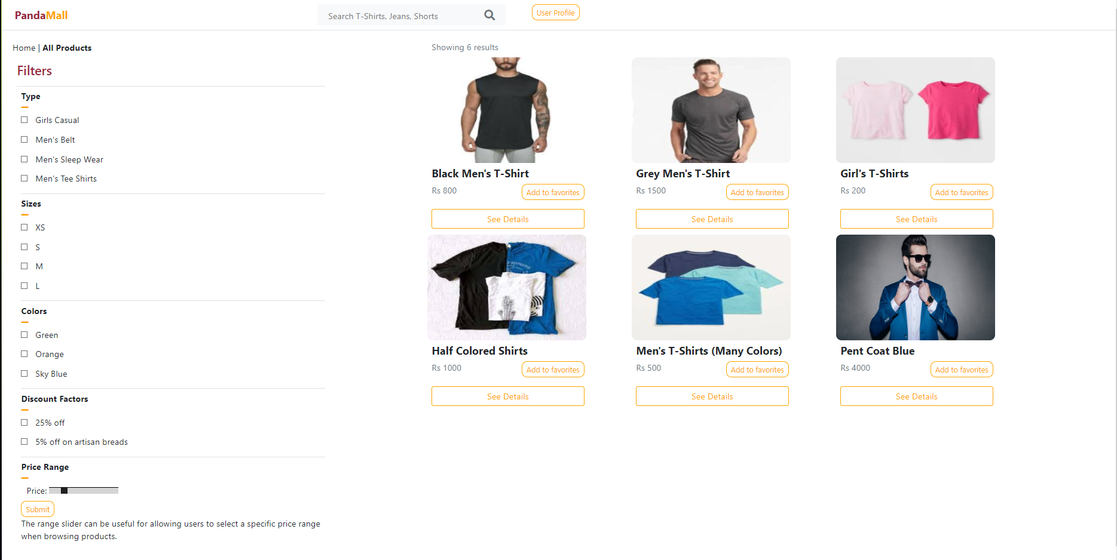
2. GOals & objectives (cont.)
4- To design a user-friendly website.

Slide 9
2. GOals & objectives (cont.)
4- To Use ML Tools (Collaborative filtering for effective & efficient recommendation engine.

Slide 10
2. Scope of the project
Three Components
1- Manual Registration of Products and Automated web Scraping.
2- Train data in ML model using collaborative filtering algorithm.
3- Website module working for the users.

Slide 11
2. Scope of the project(cont)
Not Part of the Project
Cart Function
Payment System

Slide 12
2. Intended audience
Clothing brand owners
Online shoppers
-> The aim is to facilitate both shoppers and brands to get the experience of a shopping mall online.

Slide 13



3. Overview of the System
SYSTEM USERS
CUSTOMERS
VENDORS/STORES
ADMINISTRATORS

Slide 14
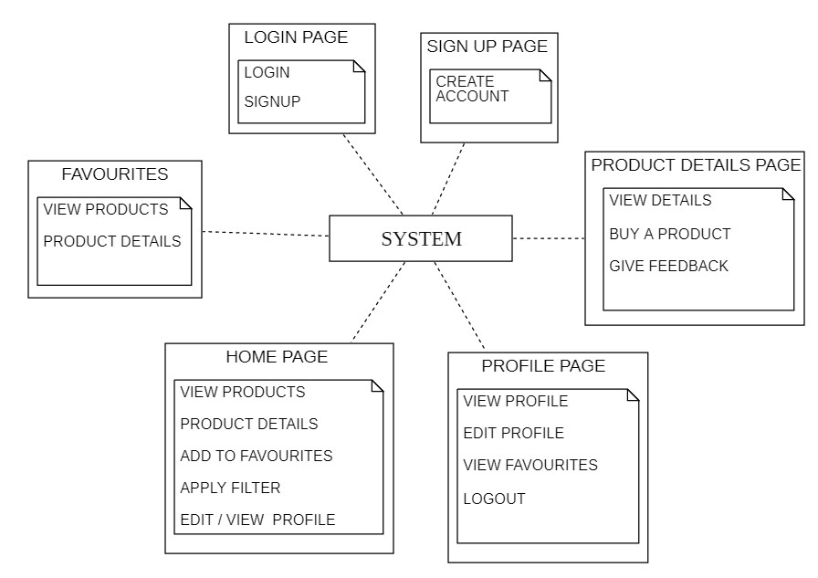
3. Overview of the System (cont.)
Customers

Slide 15
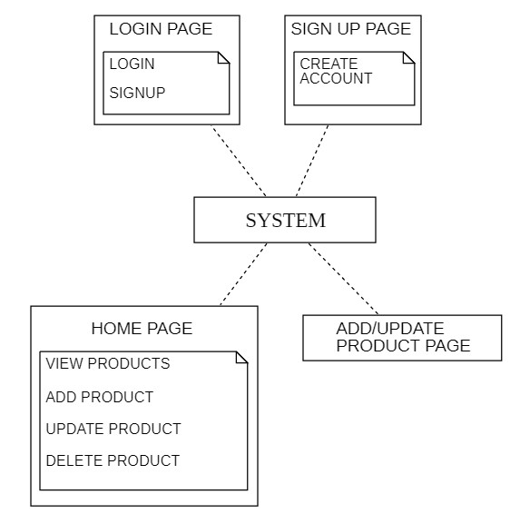
3. Overview of the System (CONT.)
Vendor/Store

Slide 16
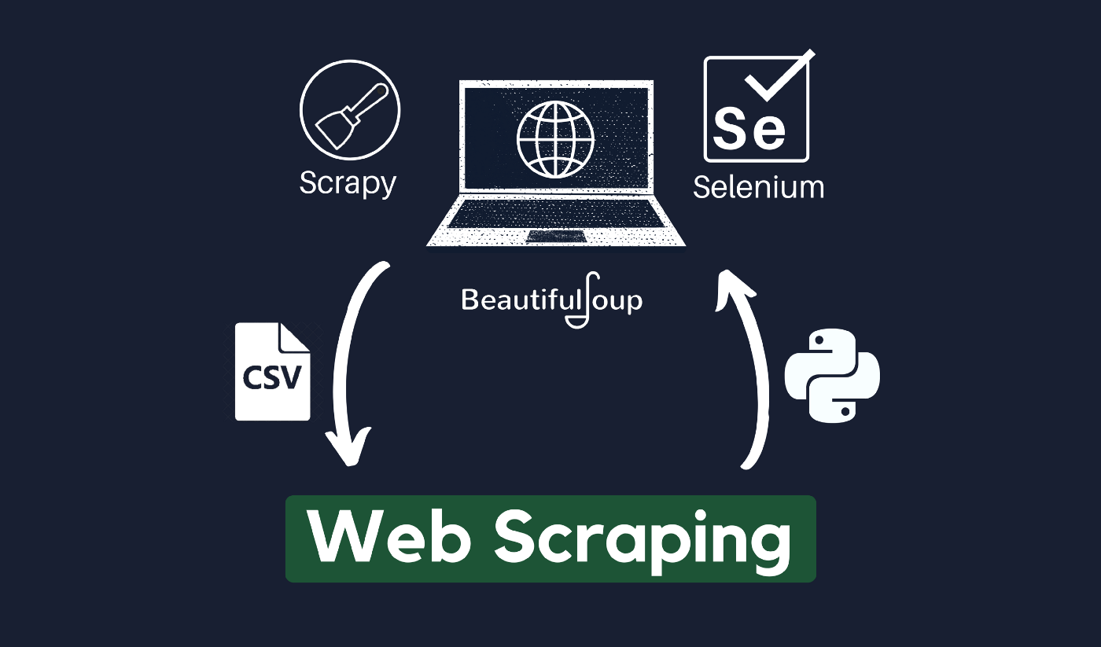
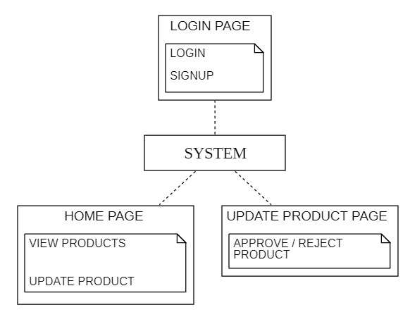
3. Overview of the System (CONT.)
Administrator

Slide 17
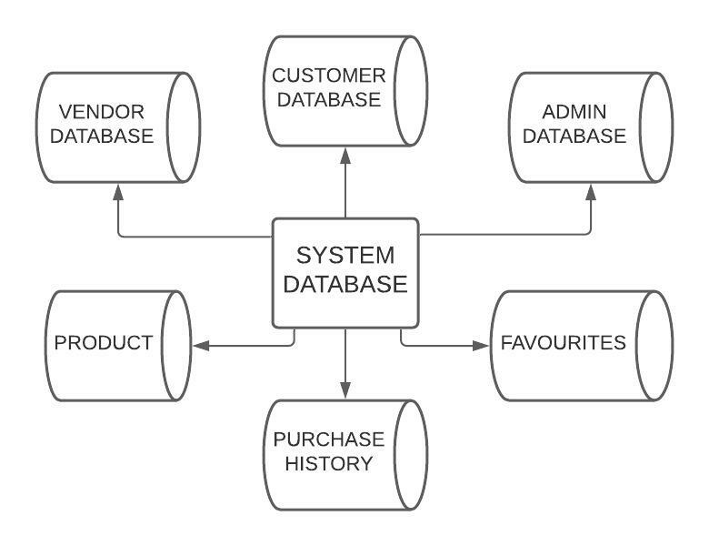
Overview of the System (CONT.)
SYSTEM DATABASE

Slide 18
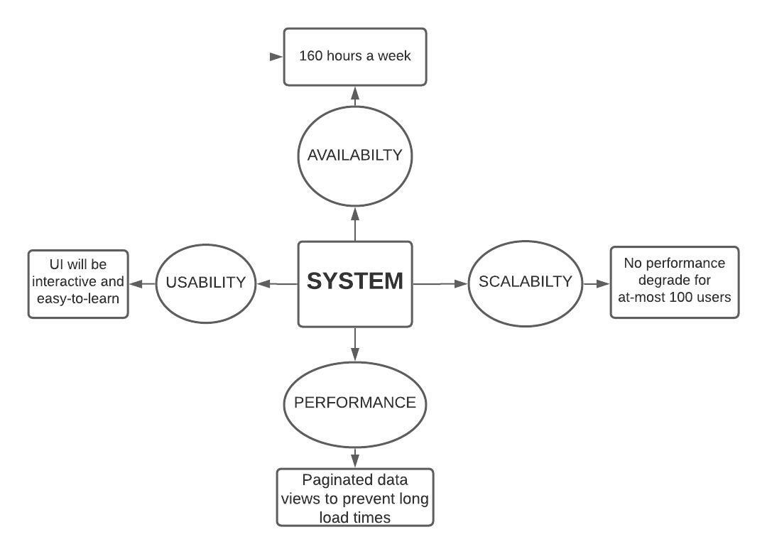
3. Overview of the System (cont.)
Non-functional requirements

Slide 19
3. Overview of the System (CONT.)
Constraints and limitations
Websites which we are going to scrape can change their layout.
Products could be neglected due to missing fields while scrapping.

Slide 20
4. Work Breakdown and Timing
Tentative breakdown for the rest of semester
Month | Week | Task
Nov | 3 | Deciding features for machine learning model
Nov | 4 | Setup Django environment
Dec | 1 | Gather, clean and initialize training data according to features
Dec | 2 | Prepare prototype for showing the working of algorithm
Dec | 3 | Learn React.js
Dec | 4 | Setup Front end of the website

Slide 21
Thanks
Do you have any question?

